Slide 1

BEAUTYCARE
GROUP 1 – AP146
Ngo Thien An
Vo Van Duc
Nguyen Dinh Minh Duc
Nguyen Thanh Kien ( C )
Doan Thanh Nhan

Slide 2

1
Practical basis
2
Introduce
Content
3
Feature of Website
4
Website Interface
5
Advantages And Disadvantages
6
Development

Slide 3
1. PRACTICAL BASIS:
Need
Supply
Pioneers
Team
Derived from shopping needs for beauty care

Slide 4
2. INTRODUCE
Convenience for customers.
Variety of code samples
Connect to the internet & Buy from anywhere
Sign up for information
Product Reviews
Customer members

Slide 5
3. FEATURE OF WEBSITE
1
Sign In/ Sign Up
2
Products gallery
3
Product detail
4
Contact us
5
About us
6
Manage cart

Slide 6
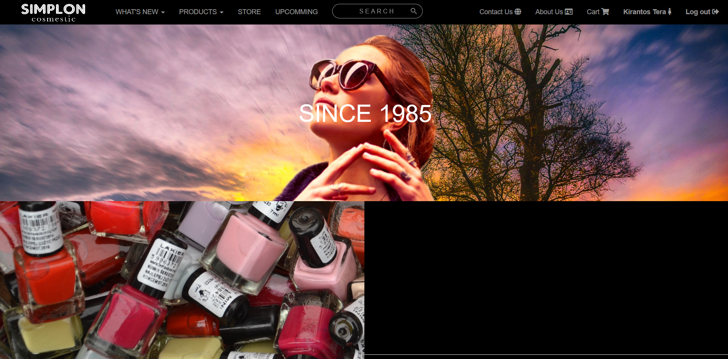
4. WEBSITE INTERFACE
Home page

Slide 7
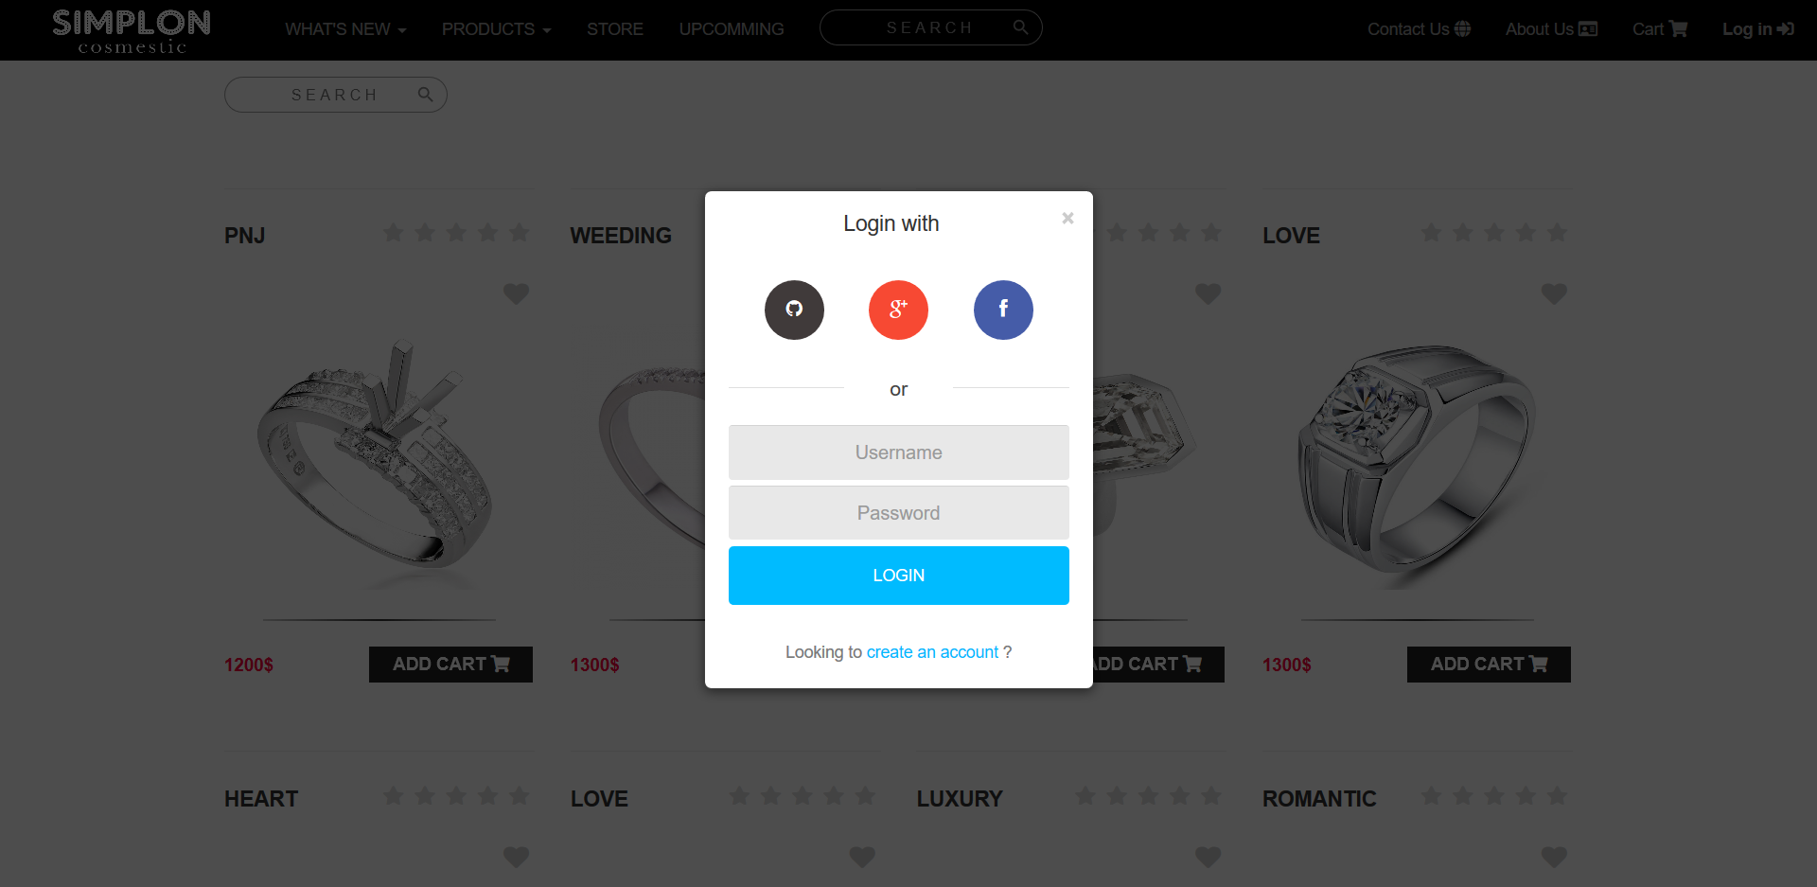
4. WEBSITE INTERFACE
Login form

Slide 8
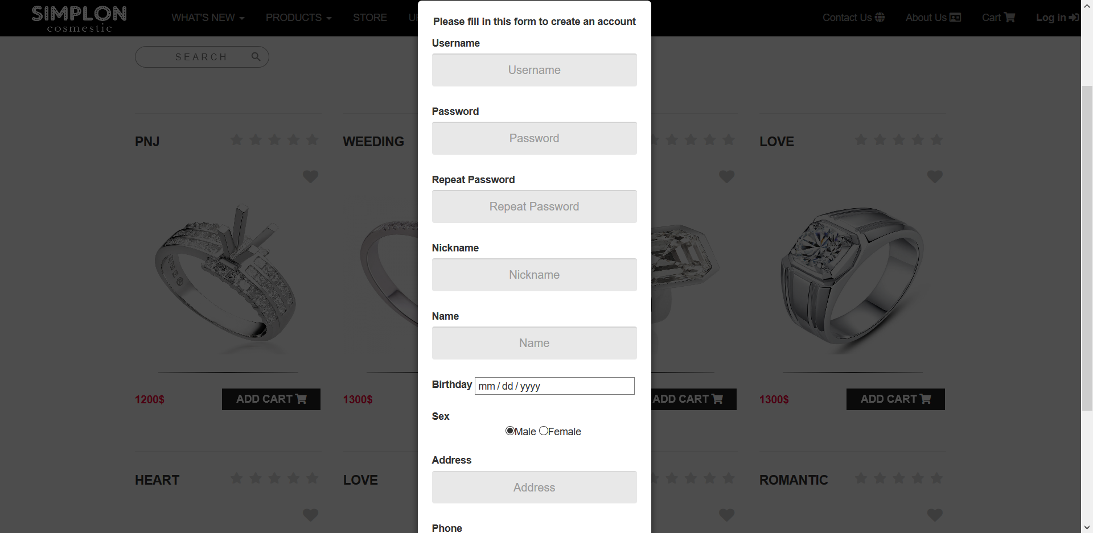
4. WEBSITE INTERFACE
Sign Up form

Slide 9
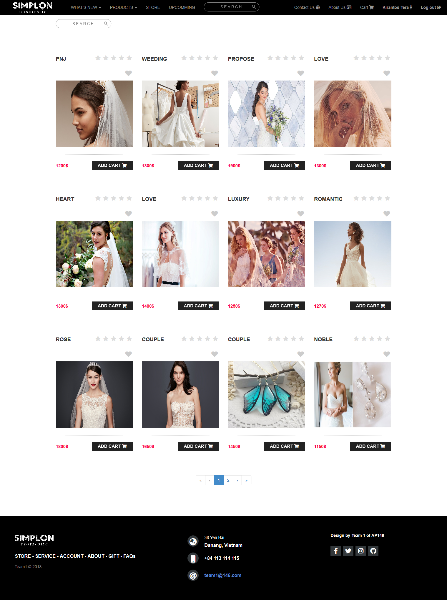
4. WEBSITE INTERFACE
Products gallery page

Slide 10
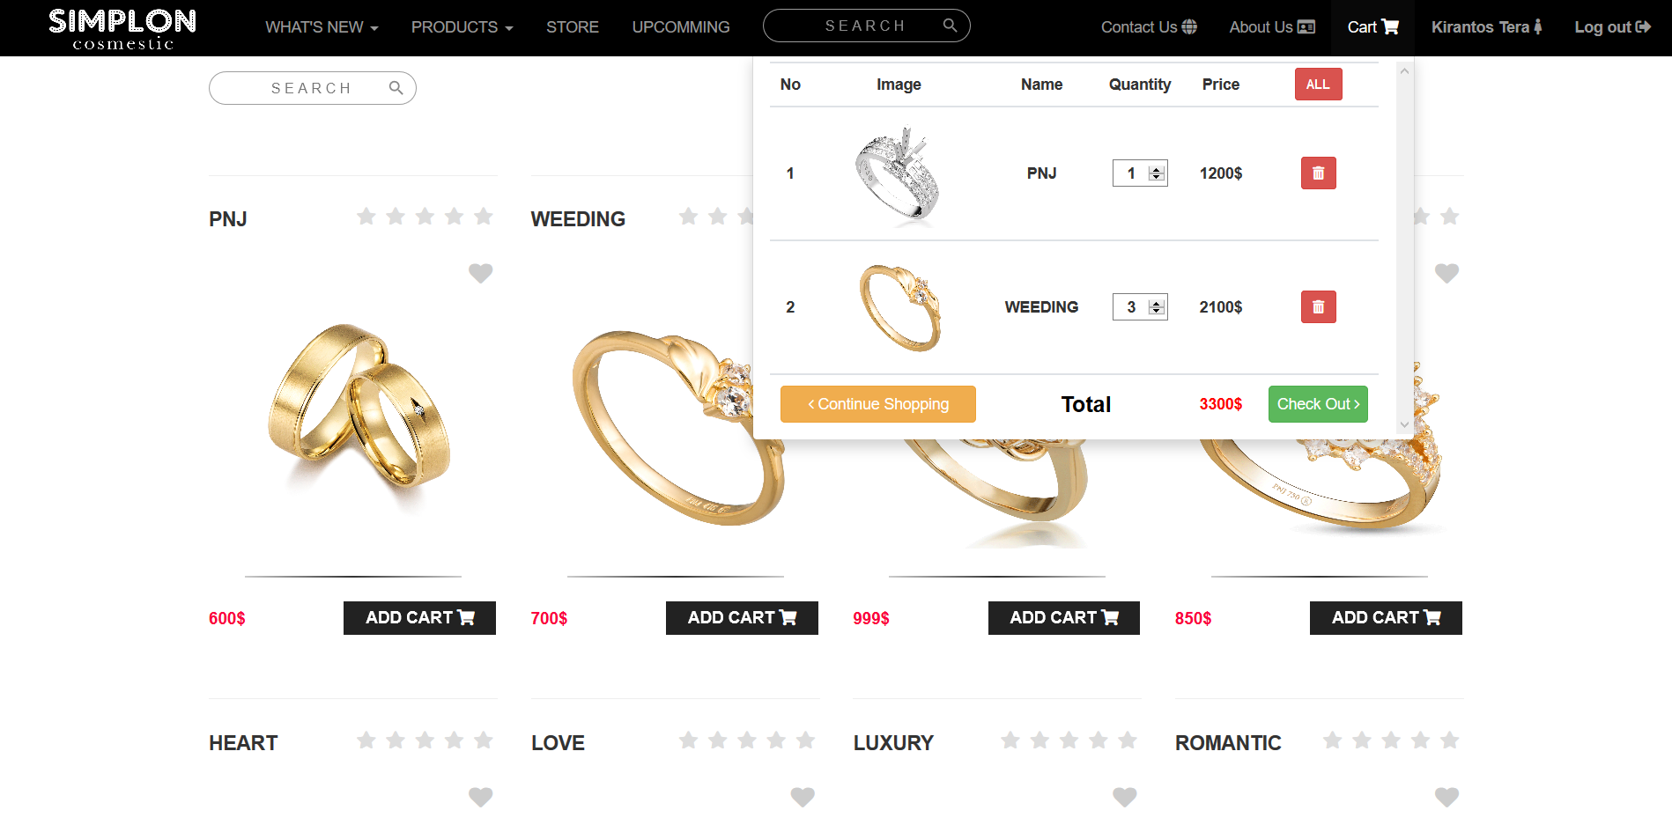
4. WEBSITE INTERFACE
Shopping cart

Slide 11
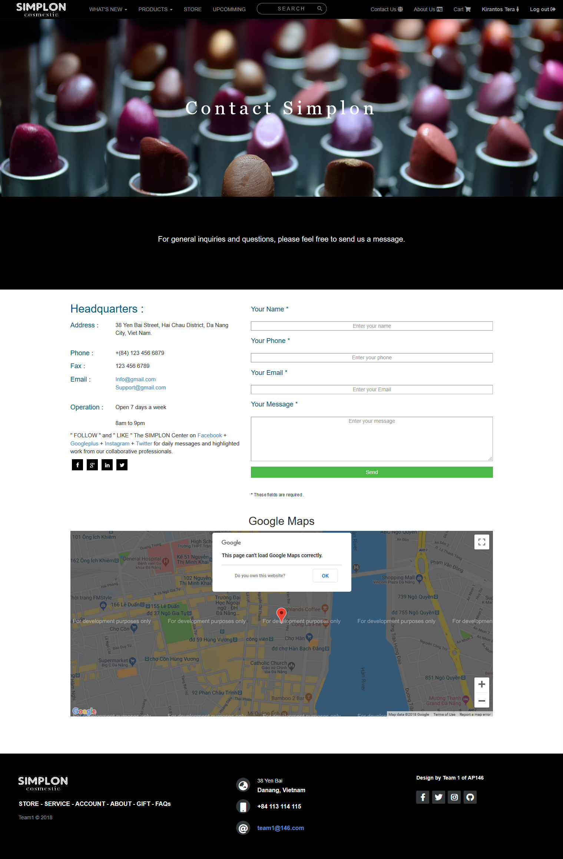
4. WEBSITE INTERFACE
Contact us page

Slide 12
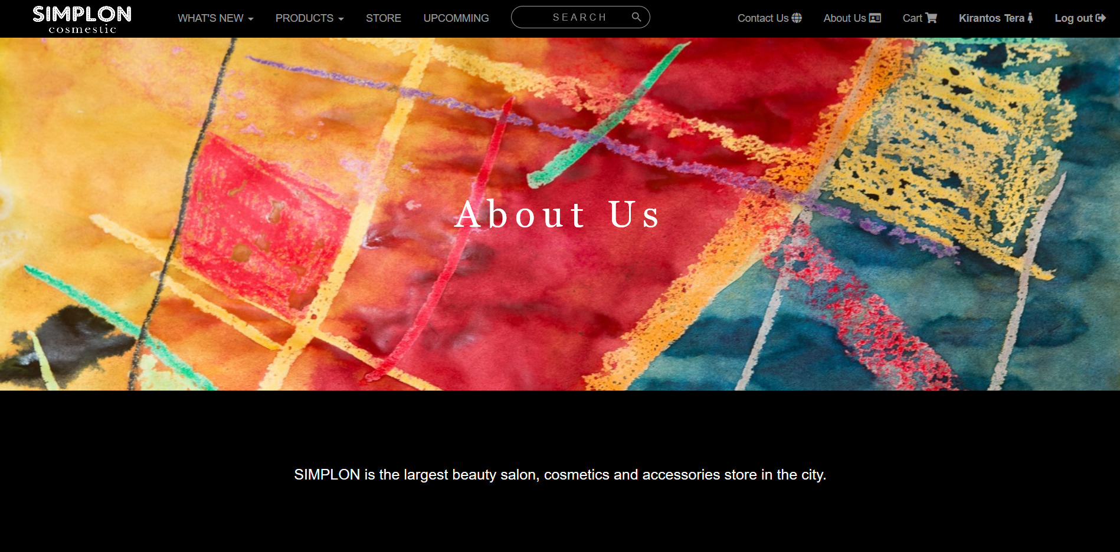
4. WEBSITE INTERFACE
About us page

Slide 13
4. ADVANCETAGES
A
D
A
V
A
T
A
G
E
S
Provide information - Product images gallery
Product detail
Can connect and share information to social network like: Facebook, Google Plus, Twitter…
User can create an account to use more function: such as manage cart
Website is SPA (Single page application)
Can connect and share information to social network like: Facebook, Google Plus, Twitter…
All pages load faster except initial loading.
Use Node JS read and write data (JSON file)
Use GIT for team work.

Slide 14
5. DISADVANCETAGES
D
I
S
A
V
A
N
T
A
G
E
S
Due to limited time and knowledge, the current website only performs some basic features, not a "dynamic" website, just stopped at the "static" website.
Because using AngularJS to make SPA so first loading is slow and code are very complex and not clean (just because we don’t have experience in coding with AngularJS and make many mistakes)
Working with Node JS in 1st time.
Later on when the knowledge of e-commerce team will develop more web site

Slide 15
5. DISADVANCETAGES
In the future, learning more about back-end groups will try to make the site more website-driven and become a bustling online shopping destination to serve the needs of all.

Slide 16


